Slide 1
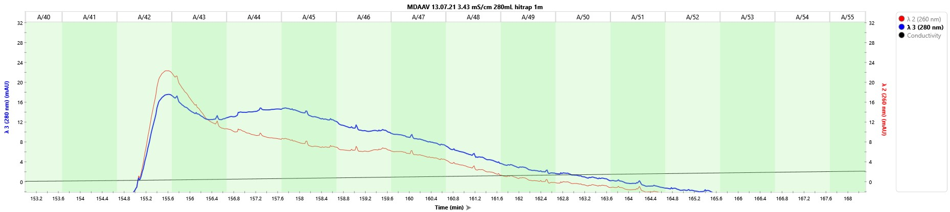
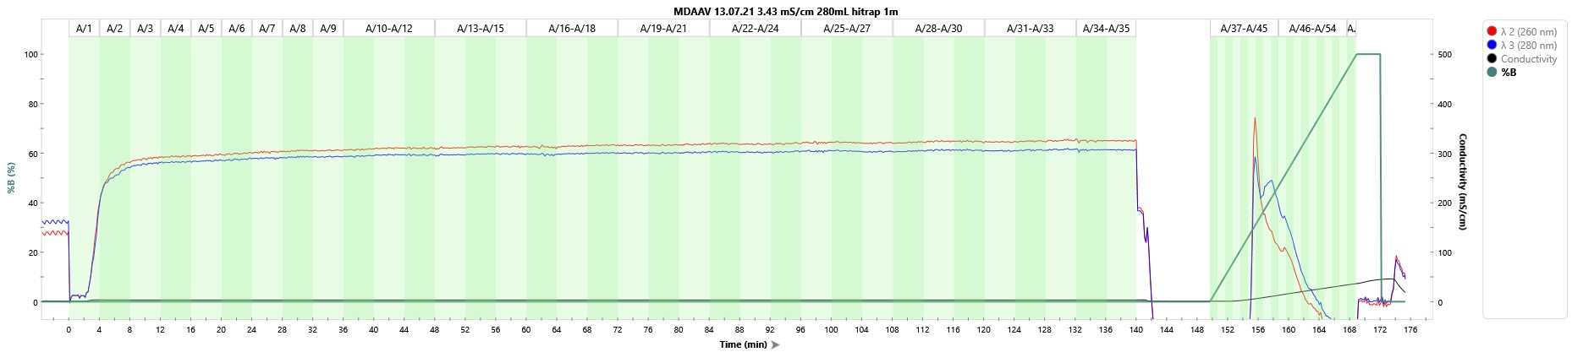
13.7.21 TFF trial
Clarification: midikros 0.2 290cm^2
Concentration and Diafiltration: TangenX cassettes, 100um, pes, 0. 1m^2
13.7.21 Purification steps (Q-XL)
Flow-Through
1st Run
Lower separation than small scale
2nd Run
Formulation: Ultracel 100KDa with Z buffer

Slide 2
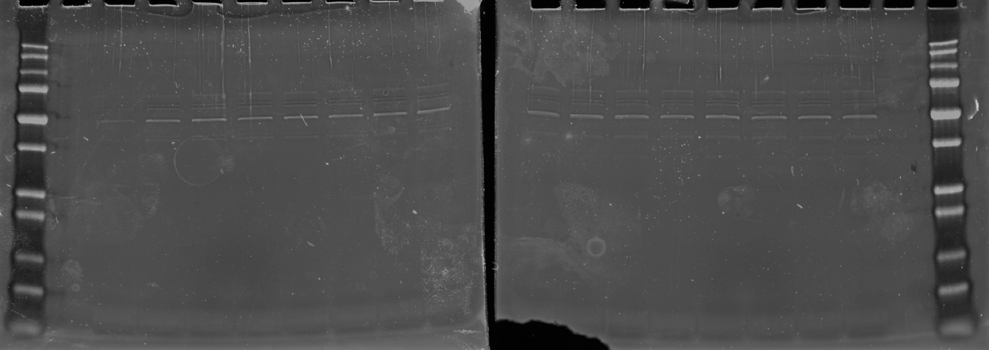

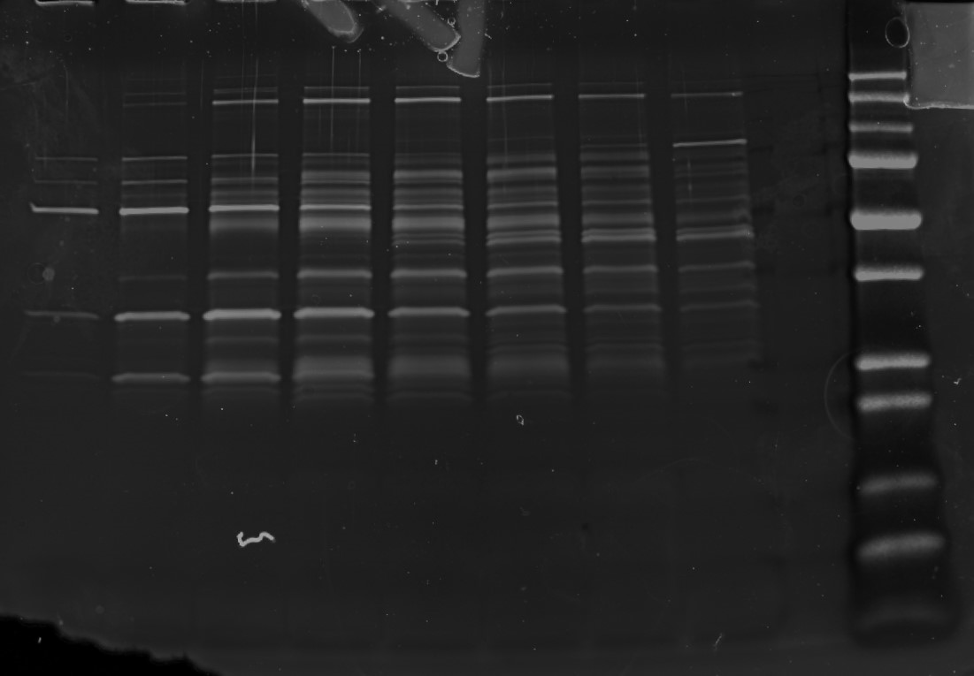
FPLC STEP-2 Flow-Through
Ruby staining
FPLC step-2(elution)
42
43
44
45
46
47
48
49
Ruby staining

Slide 3
Repeat!
Conclusions:
DNA content doesn’t match the SDS-PAGE: imply high concentration of empty capsids
Could not conclude effectivity of viral particle production on fibra-cel carriers (vs. Bionoc ii)
Significant loss of viral particles while loading on column (2nd step)

Slide 4
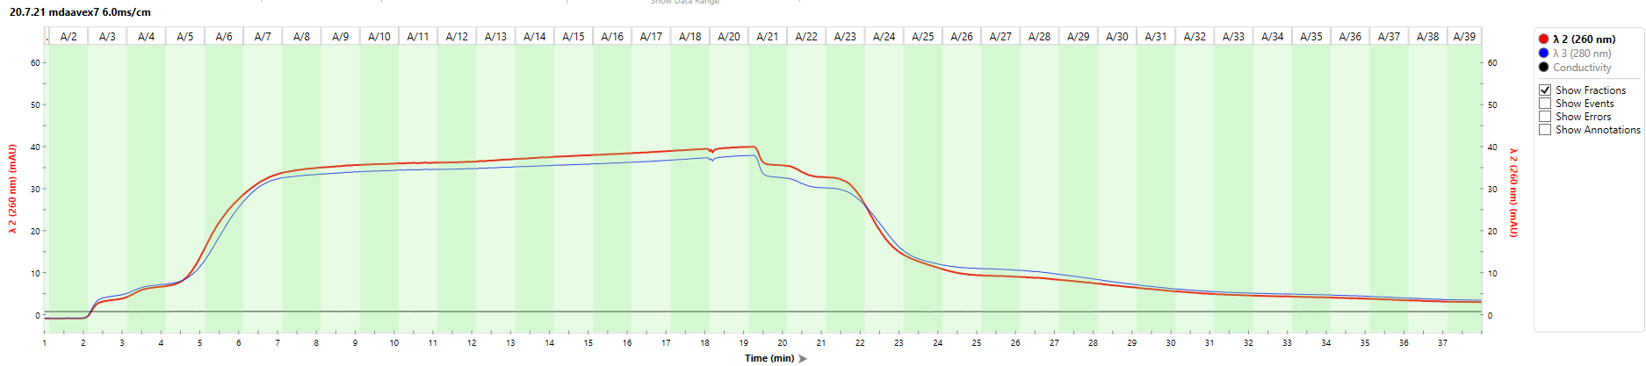
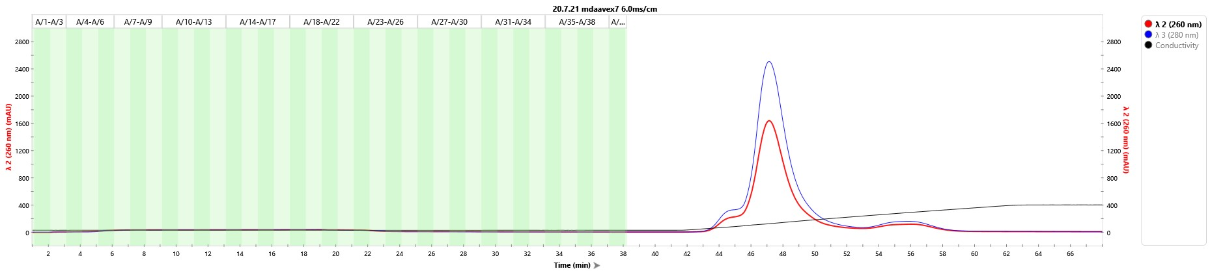
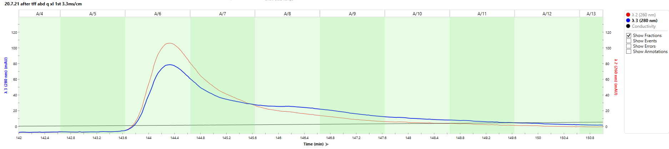
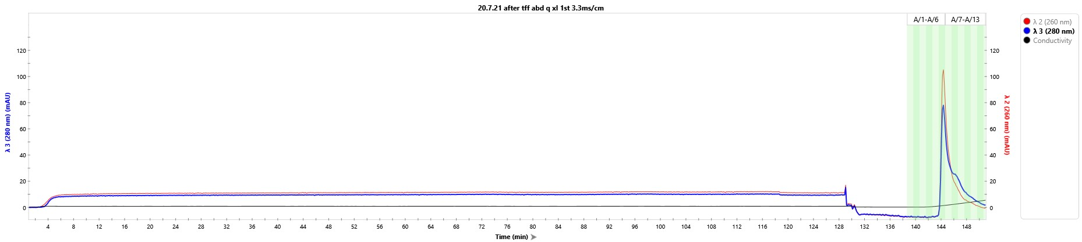
20.7.21 TFF trial
Clarification: midikros 0.2 290cm^2
Concentration and Diafiltration: TangenX cassettes, 100um, pes, 0. 1m^2
20.7.21 Purification steps (Q-XL)
Flow-Through
1st Run
Needed longer wash period
Lower separation than small scale
2nd Run
Formulation: Ultracel 100KDa with Z buffer

Slide 5
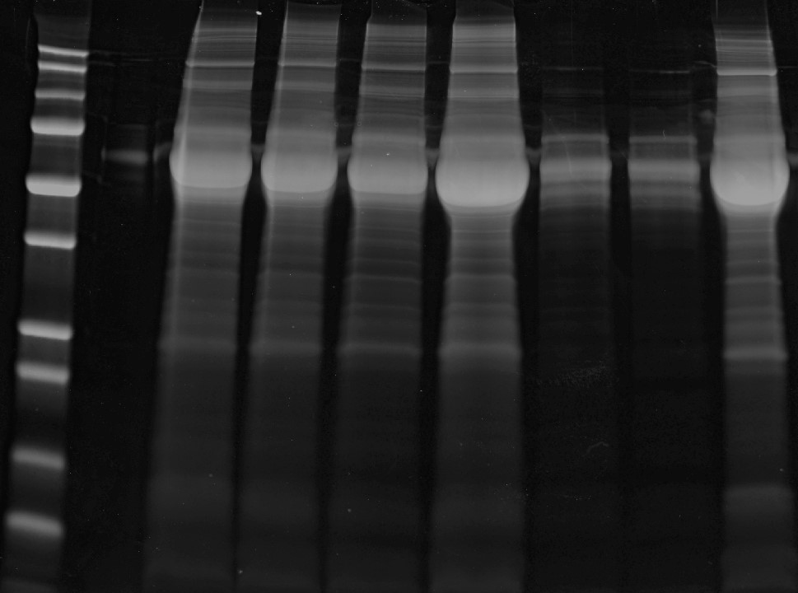
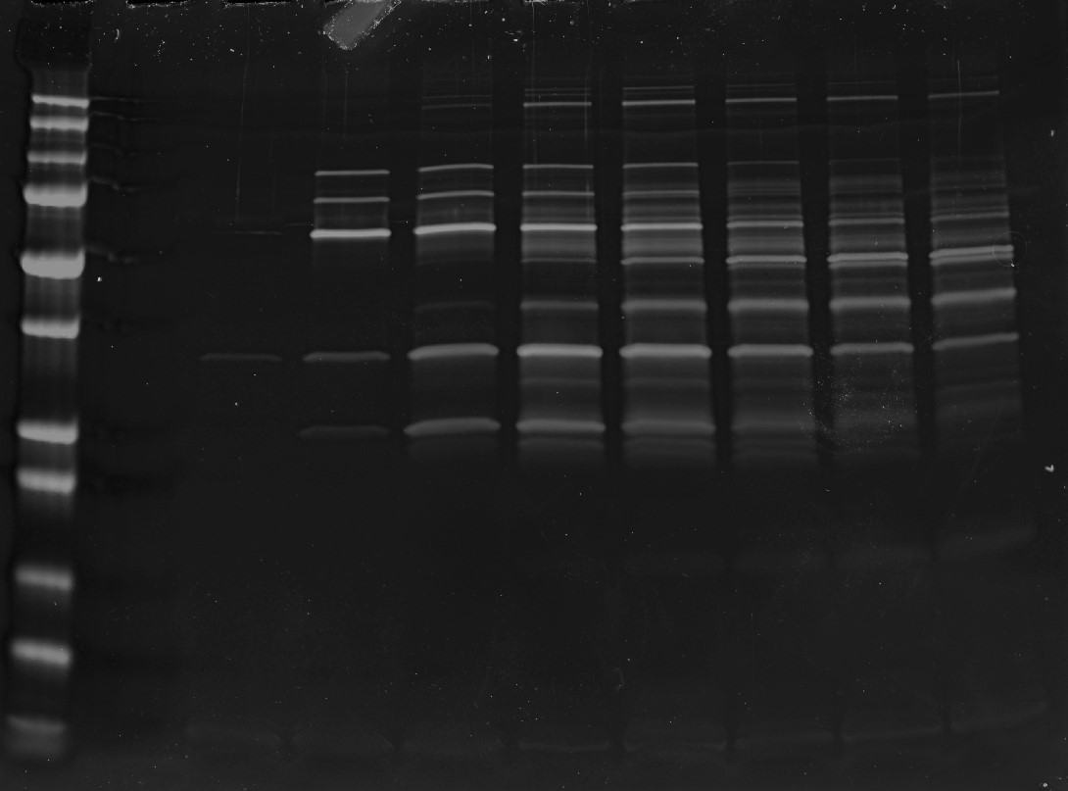
TFF step
H
0.2
S
R^{con}
F^{con}
F^{dia}
R^{dia}
Ruby staining
FPLC step-2
5
6
7
8
9
10
11
12
Ruby staining

